Slide 1







Collaboration Platform
Seamless
Collaboration
Knowledge
Sharing
Unified
Communications
And Collaboration
Knowledge
Capture
Alignment of
Information &
Knowledge
Proactive
Mining for
Knowledge
Transparent
Access to
technology
Seamless
Workflow
Intuitive
Search
Orchestration & Integration Services

Slide 2
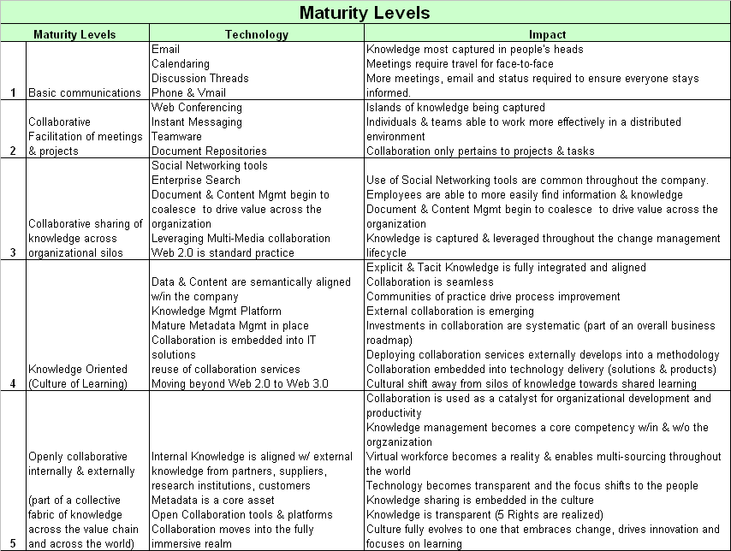
Collaboration Maturity Model

